Slide 1

Rockbuster Stealth Data Analysis
By Saher Aziz

Slide 2
Rockbuster Stealth
Rockbuster Stealth LLC is a movie rental company that used to have stores around the world. Facing stiff competition from streaming services such as Netflix and Amazon Prime, the Rockbuster Stealth management team is planning to use its existing movie licenses to launch an online video rental service i n order to stay competitive.

Slide 3
Key Questions and Objectives
Which movies contributed the most/least to revenue gain?
What was the average rental duration for all videos?
Which countries are Rockbuster customers based in?
Where are customers with a high lifetime value based?
Do sales figures vary between geographic regions?

Slide 4
Data Summary
Rental Duration (Days)
Min 3
Max 7
Avg 4.99
Movie Length (Minutes)
Min 46
Max 185
Avg 115
Rental Rate (Dollars)
Min 0.99
Max 4.99
Avg 2.98
Replacement Cost (Dollars)
Min 9.99
Max 29.99
Avg 20

Slide 5
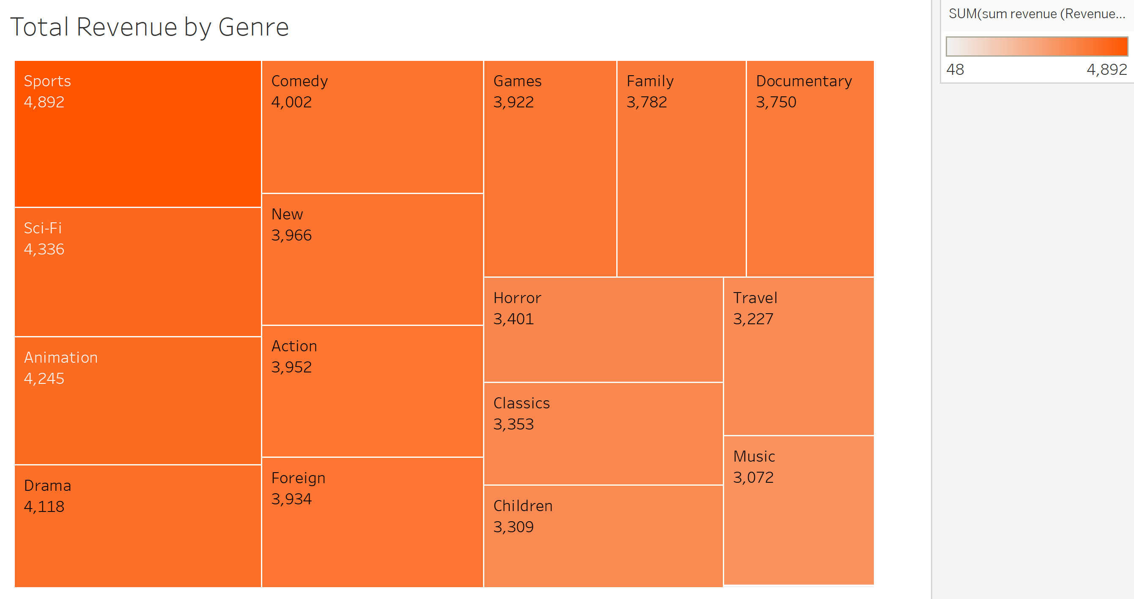
Which Movies Contributed the Most/Least to Revenue Gain?
In terms of Genre, Sports, Sci-Fi, and Animation contributed to the most Revenue.
In terms of Genre, Travel, Music, and Thriller contributed to the least Revenue.

Slide 6
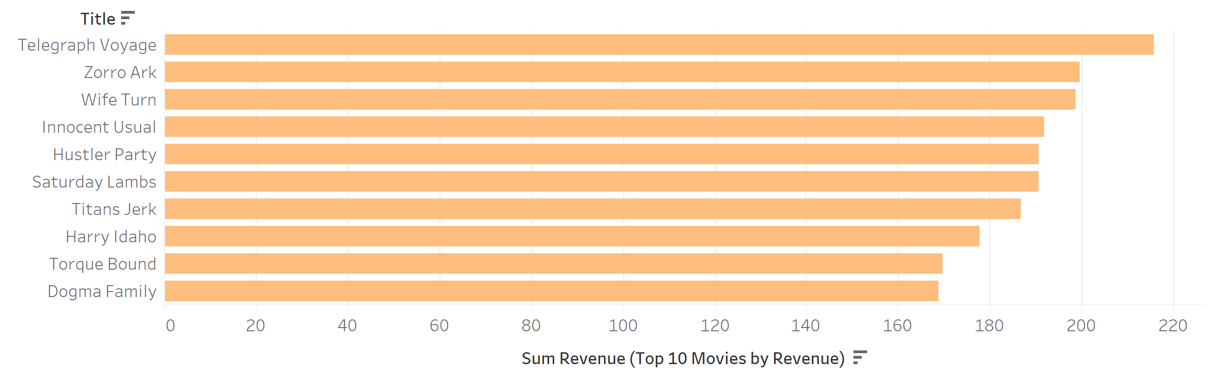
Top 10 Movies by Revenue
These Movies contributed the most to Revenue.

Slide 7
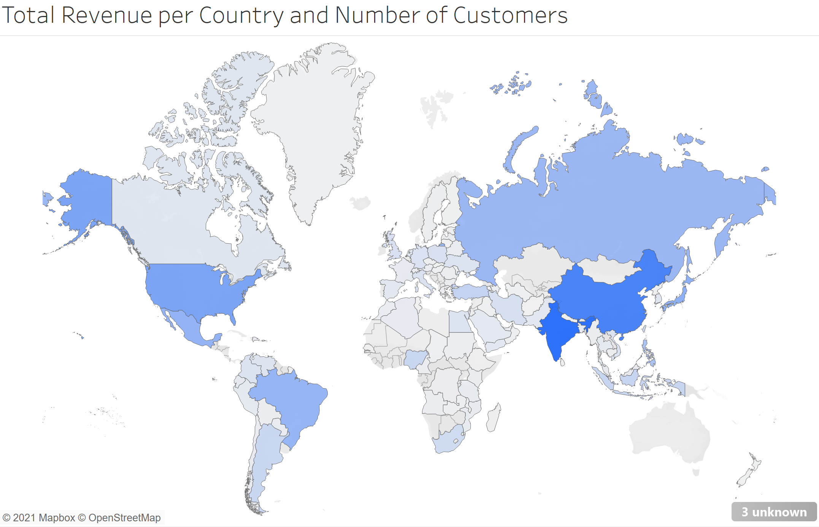
Which Countries are Rockbuster Customers Based In?
Rockbuster has Customers all over the world with the most being in India, China, and the United States.

Slide 8
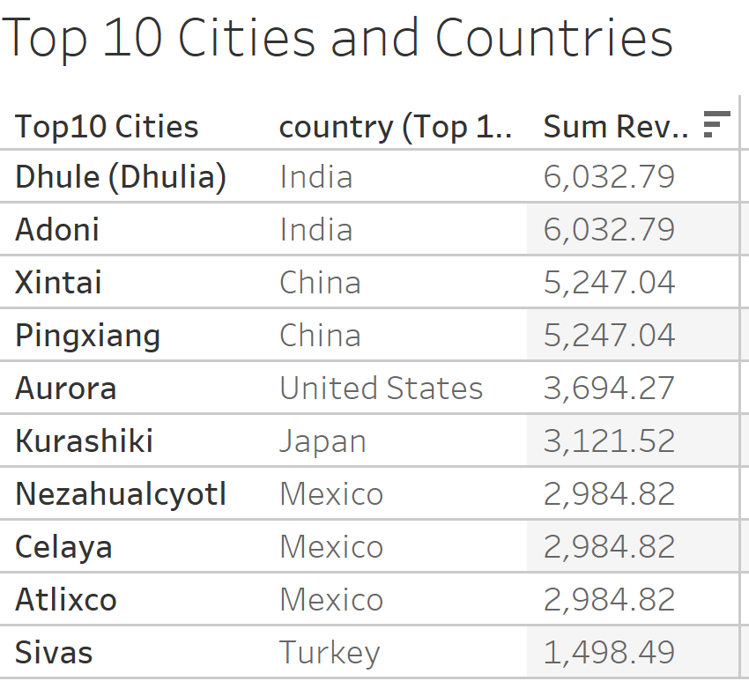
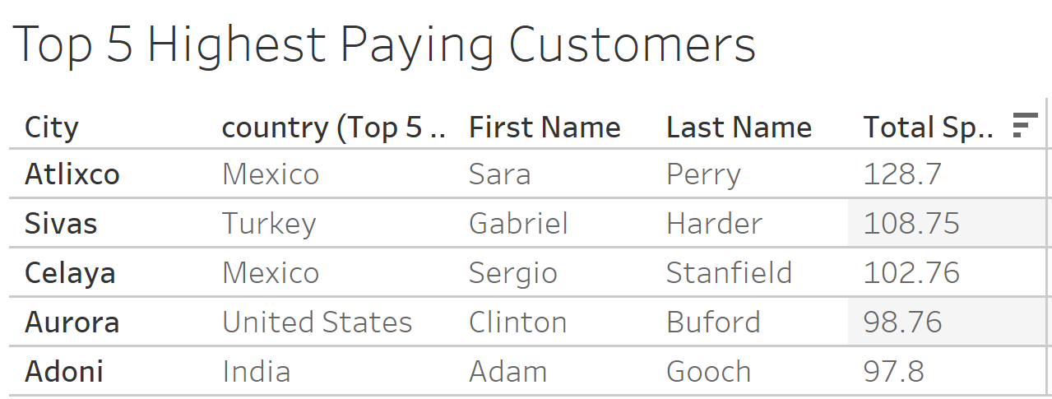
Where are Customers with a High Lifetime Value Based?
One strategy to help Rockbuster is to consider the top customers and reward them for being the top. Some requirements could include:
Being in the top Countries
Being in the top Cities.

Slide 9
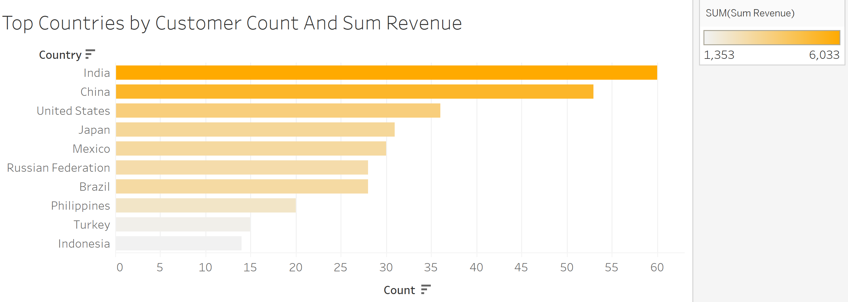
Do Sales Figures Vary Between Geographic regions?

Slide 10
Conclusions and Recommendations
Sports, Sci-Fi, and Animation contribute to the most in Revenue.
The average rental duration for all videos is 5.
India, China, and the US are the top countries in terms of Revenue and Customers.
The highest paying customers should be rewarded with discounted movie rentals.

Slide 11
Any Questions?
Click Here for the Tableau Story

